Slide 1

DIABETIC RETINOPATHY PREDICTION
GROUP 2 PRESENTS:-

Slide 2



MEET THE MEMBERS:-
RUTUJA PHADATARE
(EDA & FEATURE
ENGINEERING)
ROHIT RAJEEV
(DEPLOYMENT)
AKSHAY PHADATARE
(EDA & FEATURE
ENGINEERING)
VISHNU S K
(DEPLOYMENT)
GAJULA ANIL KUMAR
(MODEL BUILDING)
SHRUTI MARKAR
(FINAL PRESENTATION)

Slide 3

Project insight:-
Diabetic Retinopathy is a serious eye condition caused by prolonged high blood sugar levels.
It damages the blood vessels in the retina, leading to vision impairment.
It is one of the leading causes of blindness among working-age adults.
Early detection can significantly reduce the risk of vision loss. Machine Learning can help predict the likelihood of retinopathy using patient health data.

Slide 4
Project overview:-
BUSINESS OBJECTIVE:-
Develop a binary classification model to predict diabetic retinopathy.
DATASET:-
Total Records: 6000 patients
Total Features: 6 variables
Target Variable: Prognosis (0 or 1)
ID: Patient ID
Age: Patient age
Systolic BP: Pressure during heartbeats (<120 mmHg normal)
Diastolic BP: Pressure between beats (<80 mmHg normal)
Cholesterol: 125–200 mg/dl (normal range)
Prognosis:0 = No Retinopathy
1 = Retinopathy Present

Slide 5


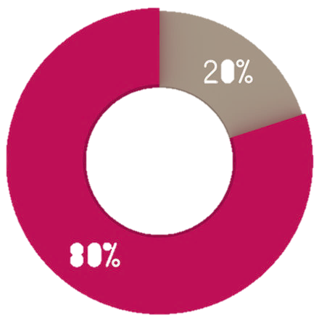





Process Workflow:-
Model Building
Training Data
Dataset
Train Model
Test Data
Data Cleaning
Feature
Engineering
Score Model
Evaluate Model

Slide 6
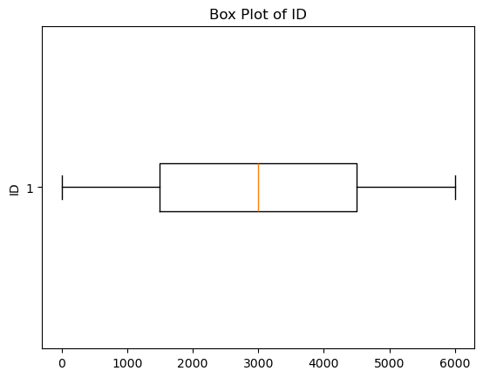
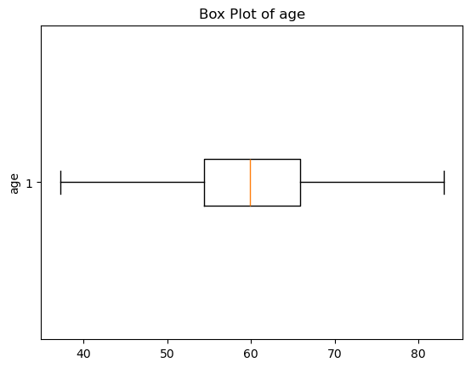
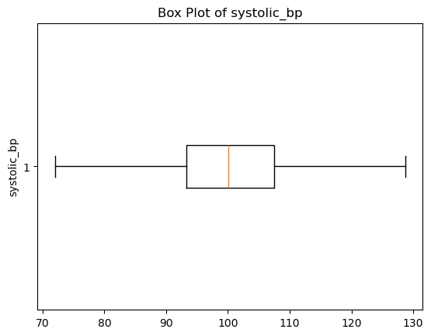
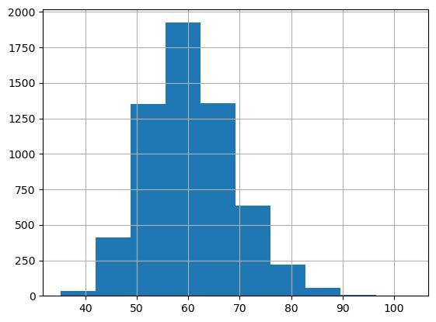
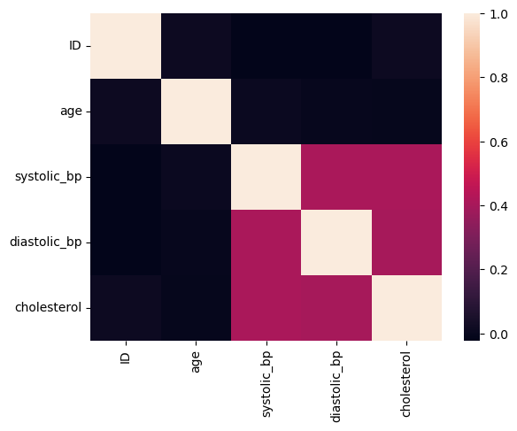
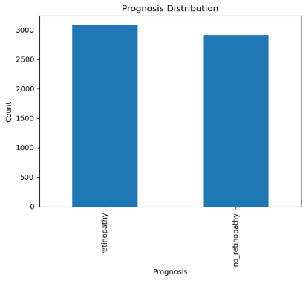
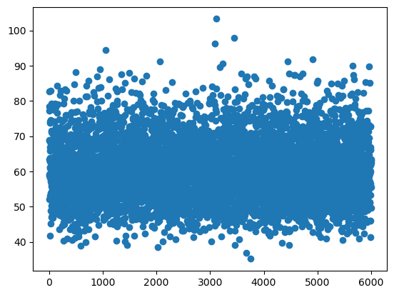
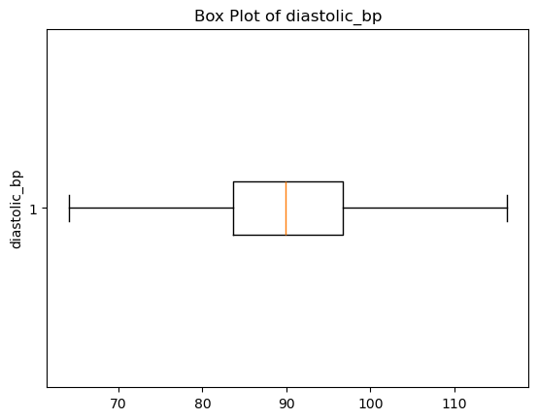
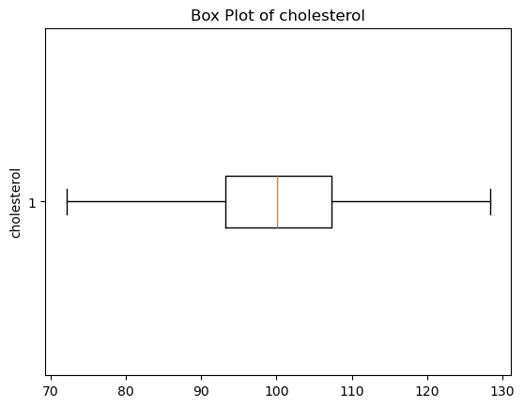
EDA & feature engineering:-
Binary classification structure identified
Age distribution is continuous & slightly skewed
Possible presence of outliers
Data appears clean and usable
Class-wise age distribution indicates partial separation
No perfect separation thus a single feature is not sufficient
EDA supports multi-feature modeling approach

Slide 7
Model building:-
 | Model | Accuracy | Precision | Recall | F1 Score
0 | Logistic Regression | 0.75 | 0.76 | 0.75 | 0.75
1 | Decision Tree | 0.74 | 0.74 | 0.78 | 0.76
2 | Random Forest | 0.74 | 0.75 | 0.75 | 0.75
3 | Gradient Boosting | 0.75 | 0.75 | 0.77 | 0.76
4 | SVM | 0.75 | 0.75 | 0.77 | 0.76
All models show similar accuracy (0.74–0.75)
Gradient Boosting & SVM show slightly higher F1 Score (0.76)
Decision Tree achieves highest recall (0.78)
Random Forest performs consistently but not superior
No model significantly outperforms others
Final Model Selected: Logistic Regression
Performance comparable to all advanced models
Balanced precision and recall; High interpretability (critical for healthcare)
Low complexity and faster execution
Model choice is supported by validation techniques; Since all models performed similarly, Logistic Regression was selected due to its stability, interpretability, and validated performance through cross-validation and ROC-AUC analysis.

Slide 8
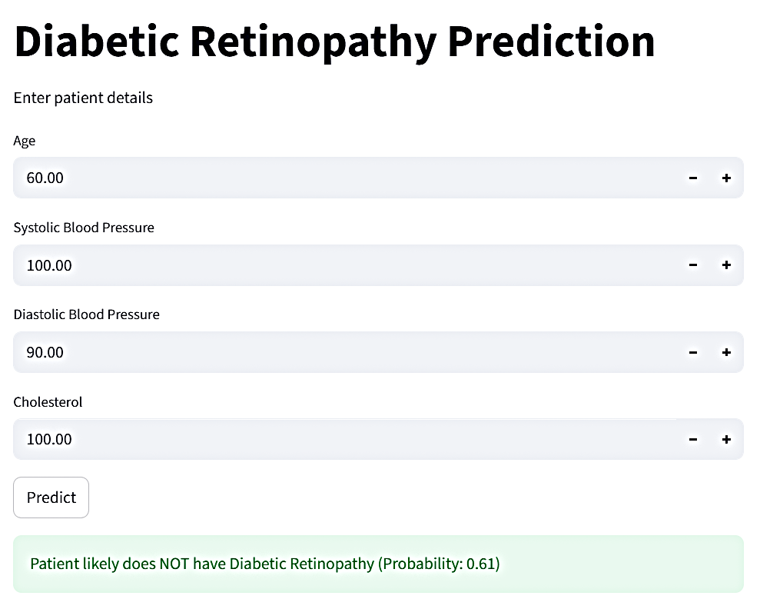
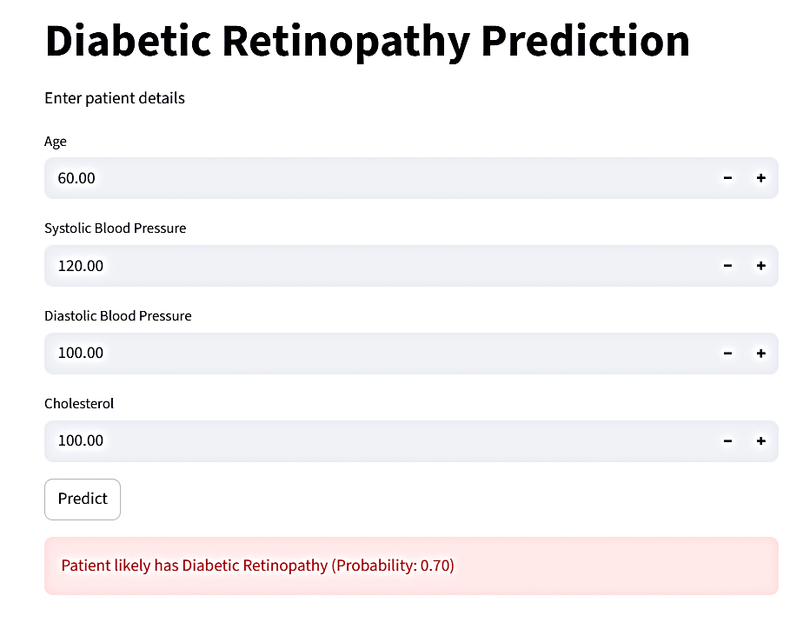
Model deployment:-
Finalized Logistic Regression model was saved for deployment
Data preprocessing steps were retained for consistency
An interactive Streamlit application was developed
Input data is processed, scaled, and passed through the model to generate results
Prediction output includes both classification and probability

Slide 9
interpretation:-
Built a complete machine learning solution from data analysis to deployment
Data analysis showed that no single factor alone can predict the disease
All models performed similarly, with around 75% accuracy
Logistic Regression was chosen for its simplicity and clarity
Model performance was validated to ensure consistency and reliability
The model was successfully turned into a user-friendly Streamlit app
The output includes both prediction and confidence level

Slide 10
Business impact:-
Future scope:-
Enables early detection of diabetic retinopathy
Supports doctors with quick decision-making
Reduces screening costs and effort
Scalable and easy to deploy solution
Improves accessibility to healthcare insights
Incorporate more clinical and lifestyle features
Integrate with real medical imaging (retina scans)
Enhance model performance using advanced algorithms
Deploy as a mobile or cloud-based application
Clinical validation and real-world testing

Slide 11
conclusion:-
The project translates data into actionable insights for healthcare use
Demonstrates how structured clinical data can support risk assessment
Creates a foundation for scalable healthcare solutions
Highlights the importance of integrating technology into everyday decision-making

Slide 12
Thank you!!

